Slide 1
Fine-tuning CNN with pre-trained VGG

Slide 2
CNN with your data

Slide 3
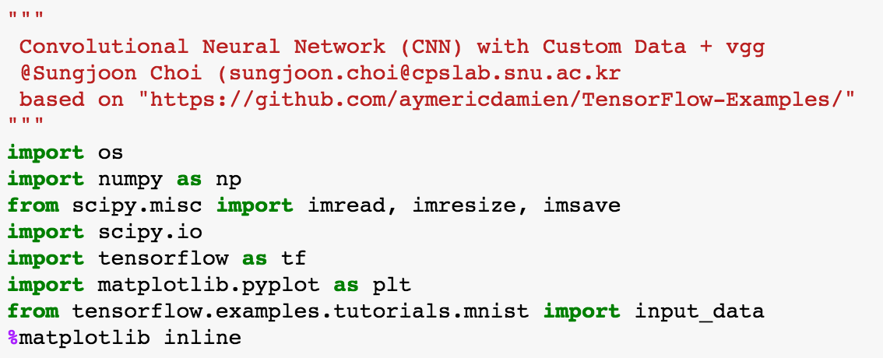
Import packages

Slide 4
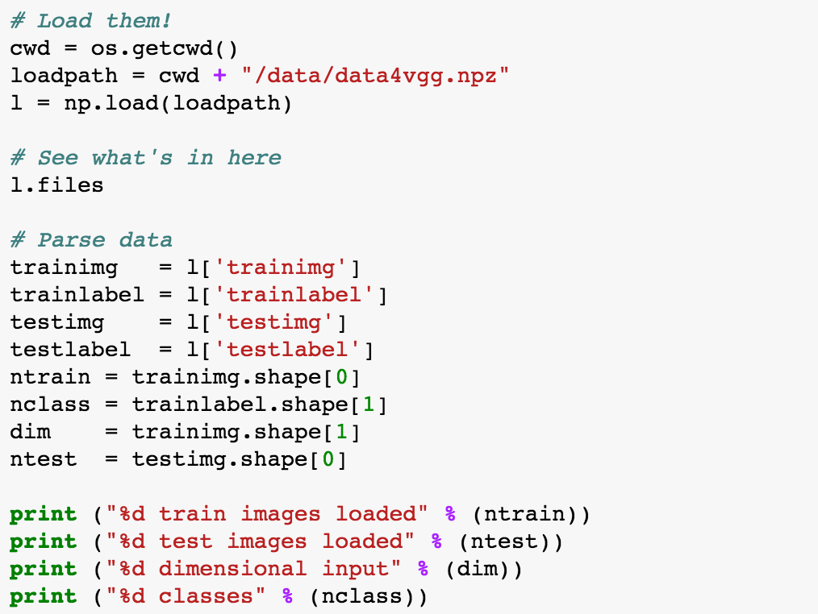
Load the data

Slide 5
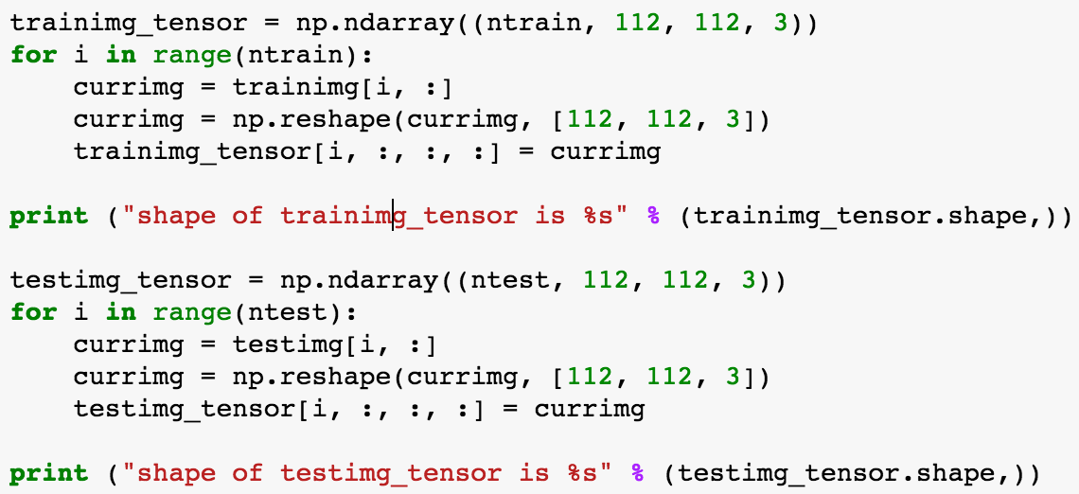

Load the data

Slide 6
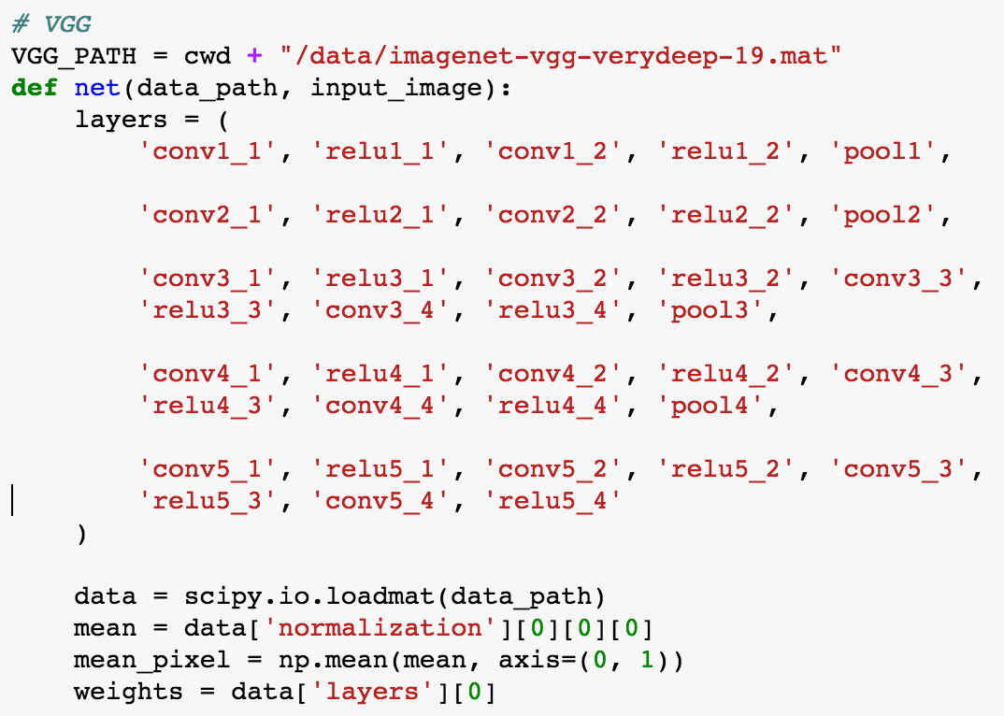
VGG

Slide 7
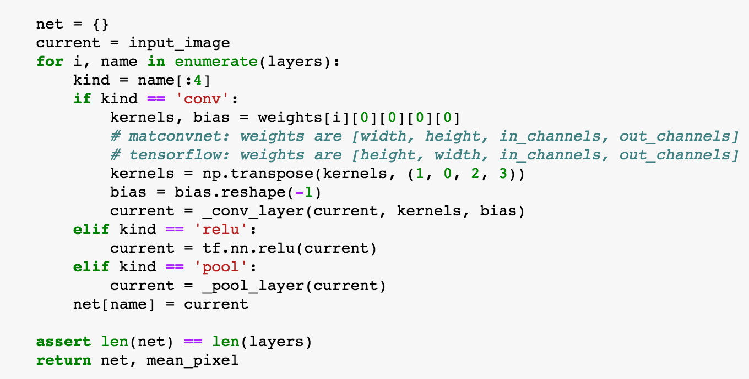
VGG

Slide 8

VGG

Slide 9


Preprocess with VGG

Slide 10
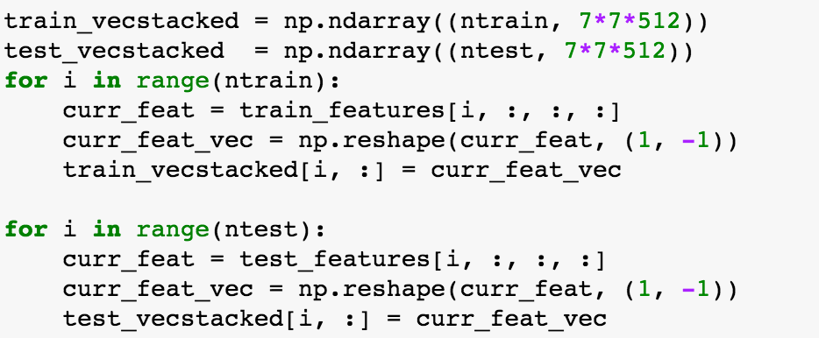
Vectorize Data

Slide 11
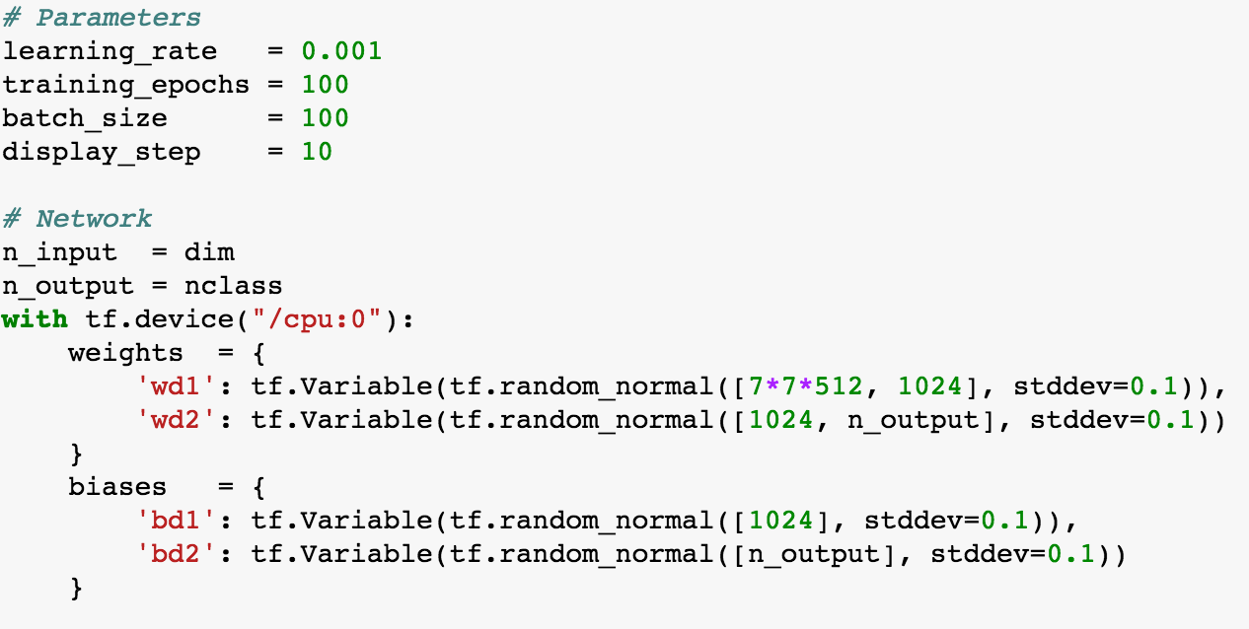
Define the CNN 1/3

Slide 12
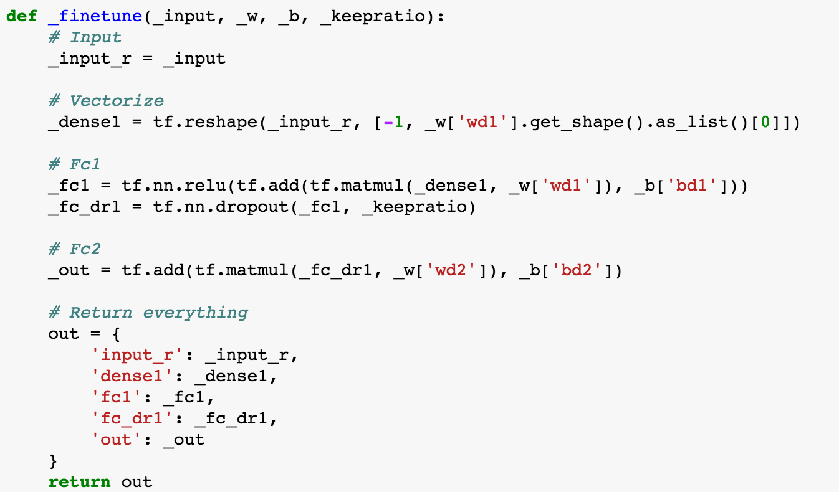
Define the CNN 2/3

Slide 13
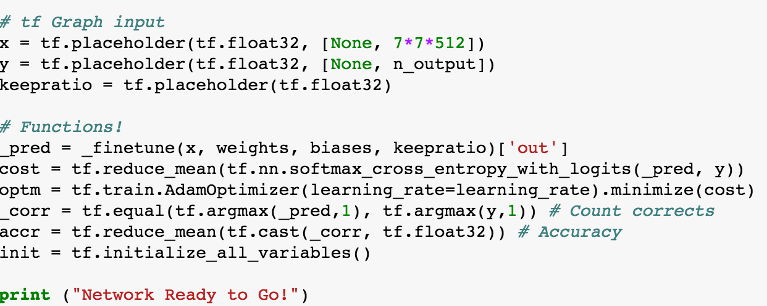
Define the CNN 3/3

Slide 14
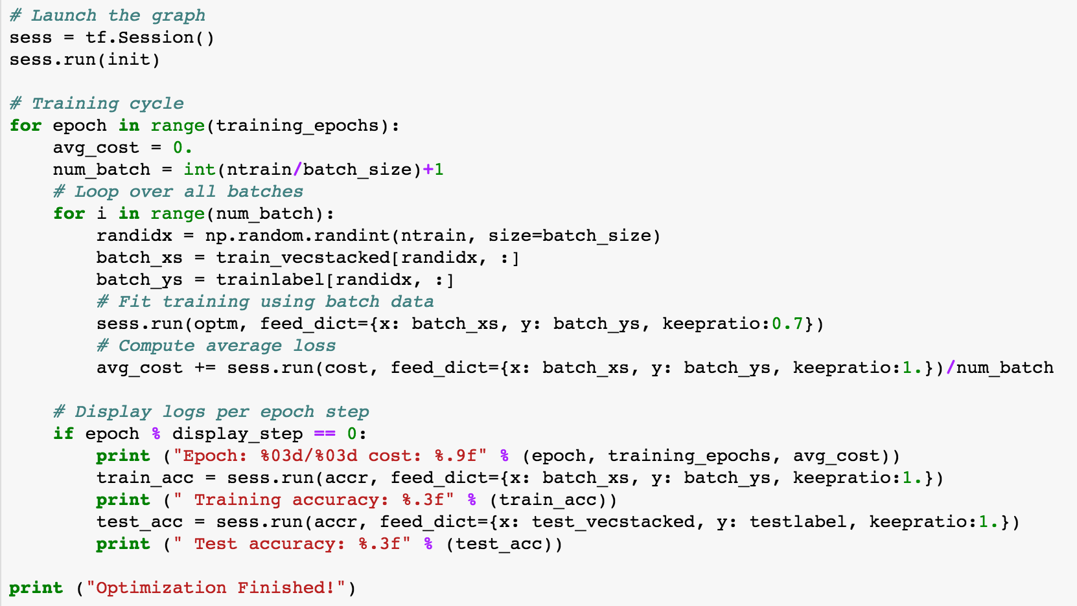
RUN!

Slide 15
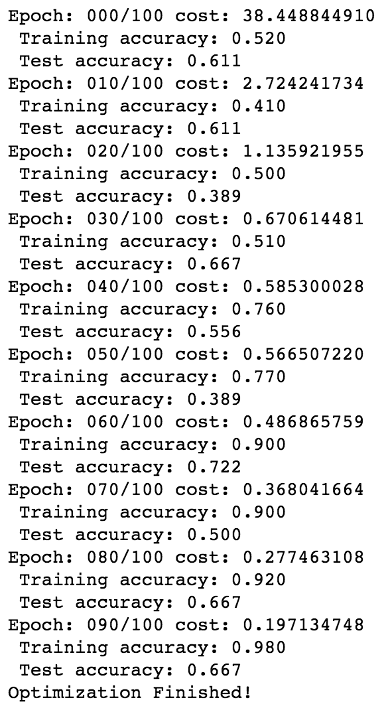
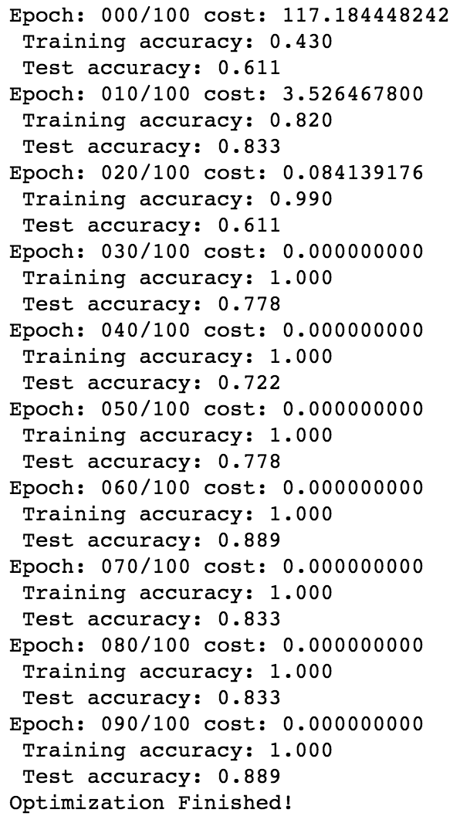
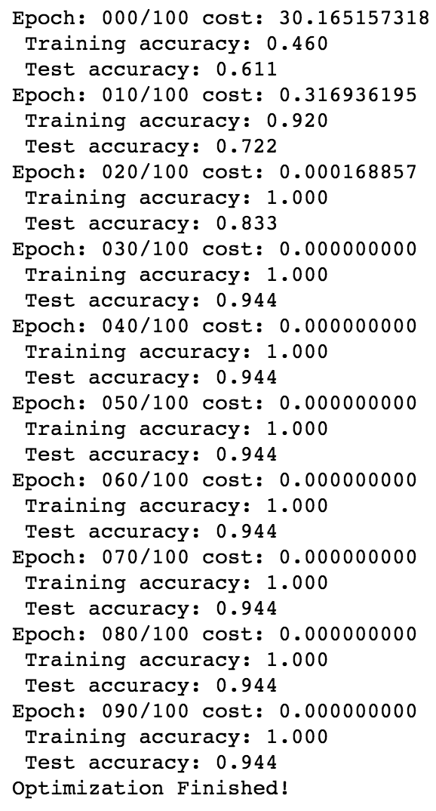
Results
Without BN
With BN
With VGG

